Slide 1
UPCOMING TOPICS FOR SD II
STATE STANDARDS
1.0 APPLY PROBLEM-SOLVING AND CRITICAL THINKING SKILLS TO INFORMATION TECHNOLOGY
1.1 Describe methods and considerations for prioritizing and scheduling software development tasks (e.g., risk- value, waterfall, agile, GTD, Kanban)
1.2 Describe methods and techniques of problem-solving and troubleshooting applicable to software development
NOTES
CONTENT
PROCEDURES
NEWS / CURRENT EVENTS
21ST CENTURY SKILLS
JOBS
CONDITIONAL STATEMENTS AND COMPOUND CONDITIONAL STATEMENTS
IF:
ELIF:
ELSE:
COUNT YOUR PARENTHESES (_(___(__(_))_____))
THE RANDOM LIBRARY
WHAT IS A VENV?
PULL REQUEST, PUSH, COMMIT, SYNCH, GIST
21 CENTURY SKILLS
CRITICAL THINKING
SOLVING COMPLEX PROBLEMS
CREATIVITY
COLLABORATION COMMUNICATION
EXPLORATION
INNOVATION
MINDFULNESS

Slide 2
UPCOMING TOPICS FOR SD II
STATE STANDARDS
1.0 APPLY PROBLEM-SOLVING AND CRITICAL THINKING SKILLS TO INFORMATION TECHNOLOGY
1.1 Describe methods and considerations for prioritizing and scheduling software development tasks (e.g., risk- value, waterfall, agile, GTD, Kanban)
1.2 Describe methods and techniques of problem-solving and troubleshooting applicable to software development
NOTES
CONTENT
PROCEDURES
NEWS / CURRENT EVENTS
21ST CENTURY SKILLS
JOBS
COMPARISON OPERATORS <=, >=, ==, !=, <, >, <>
= VS. == (ASSIGNMENT VS. COMPARISON)
x = 0
y = 1
z = 3
mylist = []
if x or y or z == 0 : mylist.append(“apples")
if x or y or z == 1 : mylist.append("dogs")
if x or y or z == 2 : mylist.append("elves")
if x or y or z == 3 : mylist.append("fruit")
Question: which would return a list of what?
21 CENTURY SKILLS
CRITICAL THINKING
SOLVING COMPLEX PROBLEMS
CREATIVITY
COLLABORATION COMMUNICATION
EXPLORATION
INNOVATION
MINDFULNESS
Answer: [“apples", "dogs", "fruit"]

Slide 3
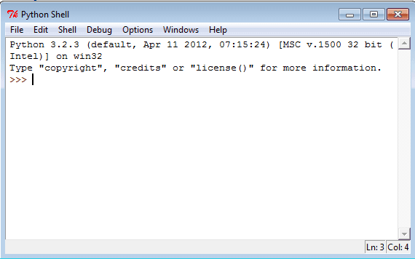
UPCOMING TOPICS FOR SD II
STATE STANDARDS
1.0 APPLY PROBLEM-SOLVING AND CRITICAL THINKING SKILLS TO INFORMATION TECHNOLOGY
1.1 Describe methods and considerations for prioritizing and scheduling software development tasks (e.g., risk- value, waterfall, agile, GTD, Kanban)
1.2 Describe methods and techniques of problem-solving and troubleshooting applicable to software development
NOTES
CONTENT
PROCEDURES
NEWS / CURRENT EVENTS
21ST CENTURY SKILLS
JOBS
WORKING WITH IDLE –
WHAT IS IDLE? - DEFINITION: AN INTEGRATED DEVELOPMENT AND LEARNING ENVIRONMENT
PROS – FAST, OLD SCHOOL, MANY TUTORIALS, BASIC SMALL INSTRUCTIONS, SIMPLE
CONS – HAVE TO SAVE AND LOAD PROGRAMS FROM SOME PLACE ELSE, NO MEMORY
NOTES
>>> MEANS “TYPE ON THIS LINE”
DO NOT WRITE “>>>” IN PYCHARM OR OTHER IDE’S
21 CENTURY SKILLS
CRITICAL THINKING
SOLVING COMPLEX PROBLEMS
CREATIVITY
COLLABORATION COMMUNICATION
EXPLORATION
INNOVATION
MINDFULNESS

Slide 4

UPCOMING TOPICS FOR SD II
STATE STANDARDS
1.0 APPLY PROBLEM-SOLVING AND CRITICAL THINKING SKILLS TO INFORMATION TECHNOLOGY
1.1 Describe methods and considerations for prioritizing and scheduling software development tasks (e.g., risk- value, waterfall, agile, GTD, Kanban)
1.2 Describe methods and techniques of problem-solving and troubleshooting applicable to software development
NOTES
CONTENT
PROCEDURES
NEWS / CURRENT EVENTS
21ST CENTURY SKILLS
JOBS
SELF GUIDED LEARNING GOAL:
DEEP UNDERSTANDING AND CONNECTION – SELF IMPROVEMENT AND SELF AWARENESS
NO SHORTCUTS – ONLY LEARNING – DO IT FOR YOURSELF – PUSH YOURSELF – DON’T RUSH
TERMS TO DEFINE – TRACEBACK AND “THE STACK”, “THE STACK OVERFLOW”
MOST COMMON ERRORS AND THEIR MEANINGS
“SOMETHING IS NOT DEFINED” “SOMETHING BEFORE ASSIGNMENT”
VARIABLES “POINT AT” INFORMATION – POINTERS, WHEN A VARIABLE IS CREATED IT IS NAMING A SPOT ON HD
21 CENTURY SKILLS
CRITICAL THINKING
SOLVING COMPLEX PROBLEMS
CREATIVITY
COLLABORATION COMMUNICATION
EXPLORATION
INNOVATION
MINDFULNESS

Slide 5

UPCOMING TOPICS FOR SD II
STATE STANDARDS
1.0 APPLY PROBLEM-SOLVING AND CRITICAL THINKING SKILLS TO INFORMATION TECHNOLOGY
1.1 Describe methods and considerations for prioritizing and scheduling software development tasks (e.g., risk- value, waterfall, agile, GTD, Kanban)
1.2 Describe methods and techniques of problem-solving and troubleshooting applicable to software development
NOTES
CONTENT
PROCEDURES
NEWS / CURRENT EVENTS
21ST CENTURY SKILLS
JOBS
YOUTUBE CHANNEL – “KIDS CAN CODE”
124 VIDEOS ACROSS 5 PLAYLISTS:
“LEARNING TO PROGRAM WITH PYTHON” (14 VIDEOS FOR AN INTRO REFRESHER)
“PYGAME TUTORIAL #2: PLATFORMER ” (19 VIDEOS BUILDING A 2D PLATFORMER)
“GAME DEVELOPMENT WITH PYGAME”(58 VIDEOS USING PYGAME TO BUILD GAMES)
“GAMEDEV: IN-DEPTH TOPICS (11 VIDEOS )
“PYGAME TUTORIAL #3: TILE-BASED GAME” (23 VIDEOS)
21 CENTURY SKILLS
CRITICAL THINKING
SOLVING COMPLEX PROBLEMS
CREATIVITY
COLLABORATION COMMUNICATION
EXPLORATION
INNOVATION
MINDFULNESS

Slide 6

UPCOMING TOPICS FOR SD II
STATE STANDARDS
1.0 APPLY PROBLEM-SOLVING AND CRITICAL THINKING SKILLS TO INFORMATION TECHNOLOGY
1.1 Describe methods and considerations for prioritizing and scheduling software development tasks (e.g., risk- value, waterfall, agile, GTD, Kanban)
1.2 Describe methods and techniques of problem-solving and troubleshooting applicable to software development
NOTES
CONTENT
PROCEDURES
NEWS / CURRENT EVENTS
21ST CENTURY SKILLS
JOBS
RESOURCE – CODEACADEMY.COM
PROS – LESSONS-BASED, SELF PACED, LOGIC-BASED,
EXTREMELY POPULAR, CAN LEARN OTHER LANGUAGES
ACTIVITY – BUILD ROCK, PAPER, SCISSORS
RESOURCE – TALKPYTHONTOME.COM – PODCAST
RESOURCE – TALKPYTHONTOME.COM – WEB RESOURCES
PYPI, ANACONDA, SKYPE, SLACK, HANGOUTS, DISCORD
21 CENTURY SKILLS
CRITICAL THINKING
SOLVING COMPLEX PROBLEMS
CREATIVITY
COLLABORATION COMMUNICATION
EXPLORATION
INNOVATION
MINDFULNESS

Slide 7

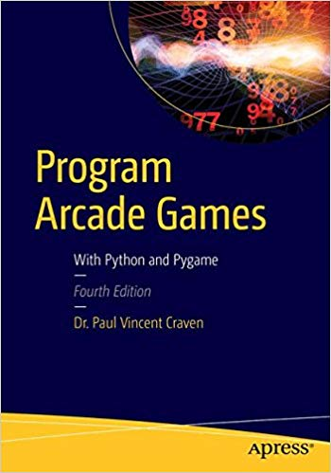
UPCOMING TOPICS FOR SD II
STATE STANDARDS
1.0 APPLY PROBLEM-SOLVING AND CRITICAL THINKING SKILLS TO INFORMATION TECHNOLOGY
1.1 Describe methods and considerations for prioritizing and scheduling software development tasks (e.g., risk- value, waterfall, agile, GTD, Kanban)
1.2 Describe methods and techniques of problem-solving and troubleshooting applicable to software development
NOTES
CONTENT
PROCEDURES
NEWS / CURRENT EVENTS
21ST CENTURY SKILLS
JOBS
RESOURCE – ATTILA TOTH
PROS – “DISCOVERY LEARNING”, 2D AND 3D GRAPHICS, USE OF
PYGLET, OPENGL,
RESOURCE – PROGRAMARCADEGAMES
PROS – “LOTS OF RESOURCE CODE TO PLAY WITH”, EASY TO ACCESS,
21 CENTURY SKILLS
CRITICAL THINKING
SOLVING COMPLEX PROBLEMS
CREATIVITY
COLLABORATION COMMUNICATION
EXPLORATION
INNOVATION
MINDFULNESS

Slide 8


STATE STANDARDS
1.0 APPLY PROBLEM-SOLVING AND CRITICAL THINKING SKILLS TO INFORMATION TECHNOLOGY
1.1 Describe methods and considerations for prioritizing and scheduling software development tasks (e.g., risk- value, waterfall, agile, GTD, Kanban)
1.2 Describe methods and techniques of problem-solving and troubleshooting applicable to software development
LEARNING STYLES
VISUAL (SPATIAL): YOU PREFER USING PICTURES, IMAGES, AND SPATIAL UNDERSTANDING
AURAL (AUDITORY): YOU PREFER USING SOUND
VERBAL (LINGUISTIC): YOU PREFER USING WORDS, BOTH IN SPEECH AND WRITING
PHYSICAL (KINESTHETIC): YOU PREFER USING YOUR BODY, HANDS, AND SENSE OF TOUCH
LOGICAL (MATHEMATICAL): YOU PREFER USING LOGIC, REASONING, AND SYSTEMS
SOCIAL (INTERPERSONAL): YOU PREFER TO LEARN IN GROUPS OR WITH OTHER PEOPLE
SOLITARY (INTRAPERSONAL): YOU PREFER TO WORK ALONE AND USE SELF-STUDY
NOTES
CONTENT
PROCEDURES
NEWS / CURRENT EVENTS
21ST CENTURY SKILLS
JOBS
LOGICAL
21 CENTURY SKILLS
CRITICAL THINKING
SOLVING COMPLEX PROBLEMS
CREATIVITY
COLLABORATION COMMUNICATION
EXPLORATION
INNOVATION
MINDFULNESS
VISUAL
VERBAL
SOLITARY
SOCIAL
AURAL
PHYSICAL

Slide 9
STATE STANDARDS
1.0 APPLY PROBLEM-SOLVING AND CRITICAL THINKING SKILLS TO INFORMATION TECHNOLOGY
1.1 Describe methods and considerations for prioritizing and scheduling software development tasks (e.g., risk- value, waterfall, agile, GTD, Kanban)
1.2 Describe methods and techniques of problem-solving and troubleshooting applicable to software development
LEARNING STYLES
NOTES
CONTENT
PROCEDURES
NEWS / CURRENT EVENTS
21ST CENTURY SKILLS
JOBS
VISUAL PICTURES, IMAGES, SPATIAL LOOKING AT CODE SEEING WHAT WORKS YOUTUBE GITHUB | AURAL WORDS, SPEECH, WRITING PODCASTS (TALK PYTHON TO ME) DISCUSSION PROBLEM SOLVING QUESTIONS | PHYSICAL BODY, HANDS,TOUCH ELECTRONICS ROBOTICS MANIPULATIVES LIKE CARDS , COINS AND DICE | LOGICAL LOGIC, REASONING, SYSTEMS LOOKING @ CODE IN SILENCE FOLLOWING STEPS REASONING DESIGN | VERBAL WORDS, SPEECH, WRITING DISCUSSION PLANNING DOCS AND BOOKS CODEACADEMY.COM
LOGICAL
21 CENTURY SKILLS
CRITICAL THINKING
SOLVING COMPLEX PROBLEMS
CREATIVITY
COLLABORATION COMMUNICATION
EXPLORATION
INNOVATION
MINDFULNESS
VISUAL
VERBAL
SOLITARY
SOCIAL
AURAL
PHYSICAL

Slide 10

UPCOMING TOPICS FOR SD II
STATE STANDARDS
1.0 APPLY PROBLEM-SOLVING AND CRITICAL THINKING SKILLS TO INFORMATION TECHNOLOGY
1.1 Describe methods and considerations for prioritizing and scheduling software development tasks (e.g., risk- value, waterfall, agile, GTD, Kanban)
1.2 Describe methods and techniques of problem-solving and troubleshooting applicable to software development
NOTES
CONTENT
PROCEDURES
NEWS / CURRENT EVENTS
21ST CENTURY SKILLS
JOBS
LEARNING MODES - “LET’S LOOK AT HOW YOU LEARN”
HERE IS A LIST OF WAYS THAT YOU CAN USE YOUR LEARNING/RESEARCH TIME IN THIS CLASS:
WATCH – PAUSE – WRITE QUESTIONS/HAVE DISCUSSION W/ TEACHER/CLASSMATE
WATCH – PAUSE – CODE/EXPERIMENT – UNPAUSE – CONTINUE
DEBUGGING / SOLVE PROBLEMS / FIX CODE AND COMMENT
WATCH X1 W/ NO DISTRACTIONS 100% FOCUS
WATCH – PAUSE – TAKE NOTES – UNPAUSE
READ – CODE YOUR NEW KNOWLEDGE
DOWNLOAD CODE AND TWEAK
WATCH – REWATCH – REWATCH
READ – TAKE NOTES
COLLABORATE
CODEACADEMY
NOTICE THAT ALL OF THESE ARE ACTIVE, FOCUSED AND AWAKE
21 CENTURY SKILLS
CRITICAL THINKING
SOLVING COMPLEX PROBLEMS
CREATIVITY
COLLABORATION COMMUNICATION
EXPLORATION
INNOVATION
MINDFULNESS

Slide 11



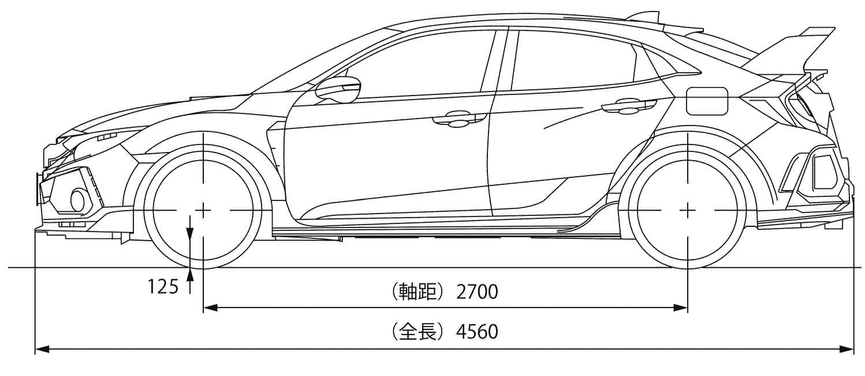
STATE STANDARDS
1.0 APPLY PROBLEM-SOLVING AND CRITICAL THINKING SKILLS TO INFORMATION TECHNOLOGY
1.1 Describe methods and considerations for prioritizing and scheduling software development tasks (e.g., risk- value, waterfall, agile, GTD, Kanban)
1.2 Describe methods and techniques of problem-solving and troubleshooting applicable to software development
OBJECT-ORIENTED PROGRAMMING
PROCEDURAL VS. OBJECT-ORIENTED
NOTES
CONTENT
PROCEDURES
NEWS / CURRENT EVENTS
21ST CENTURY SKILLS
JOBS
CLICK ON CAR OR COIN TO SEE A CLASS CREATE AN INSTANCE OF THAT CLASS
INSTANCE CLASS
21 CENTURY SKILLS
CRITICAL THINKING
SOLVING COMPLEX PROBLEMS
CREATIVITY
COLLABORATION COMMUNICATION
EXPLORATION
INNOVATION
MINDFULNESS
INSTANCE CLASS

